Slide 1



TensorLfow Object Detection
Team Name : NEU Hackers
Shreyas Redij - 001053076
Bryan Michael Pereira - 001020476
Navaneeta Naik - 001027107
Marisa Thomas - 001020479

Slide 2


Table of Contents
Problem Statement
Cityscape Dataset
Approach for Object Detection and Segmentation
Results
Application and Future scope
References

Slide 3
Problem Statement
Object detection is a deep learning technology that deals with detecting instances of semantic objects
Object recognition is a general term to describe a collection of related computer vision tasks that involve identifying objects in digital photographs.
Object Detection is used for autonomous vehicles, smart video surveillance, facial detection
SSD Mobile Net for object Detection as it provides good accuracy as compared to that of Faster RCNN
Instance segmentation is achieved by using Mask RCNN which is extension of Faster CNN
K-means clustering for Region based Segmentation

Slide 4
Cityscapes Dataset
Cityscapes Dataset focuses on semantic understanding of urban street scenes
Features of Dataset
Diversity
50 cities
Several months (spring, summer, fall)
Manually selected frames
Large number of dynamic objects
Varying scene layout
Varying background
The Dataset contains some classes which is like that of COCO Dataset

Slide 5
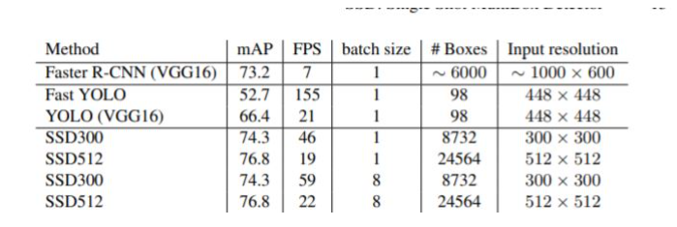
Approach for Detection
The mobilenet-ssd model is a Single-Shot multibox Detection (SSD) network intended to perform object detection
We have used a pretrained model on COCO dataset
Comparison of SSD with other models is shown

Slide 6
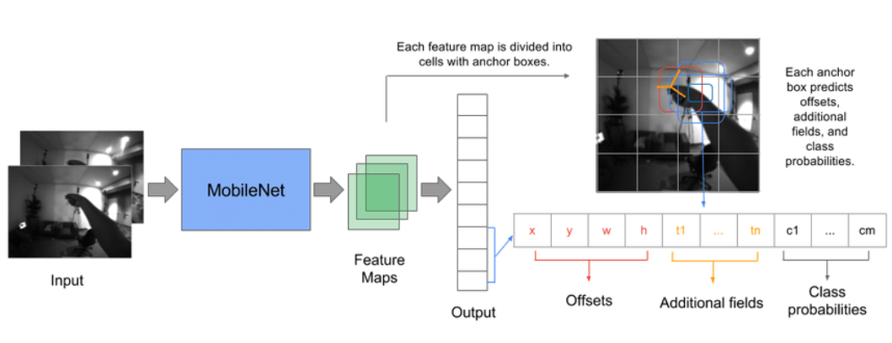
SSd-MobileNet Architecture

Slide 7
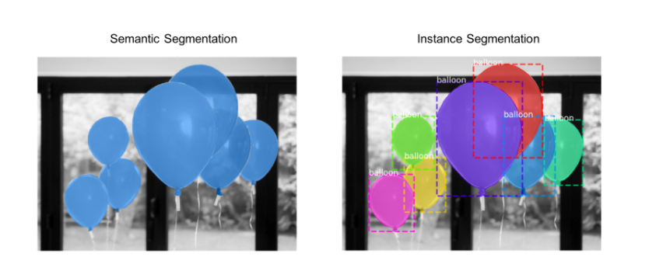
Region based clustering and Image Segmentation
K means Clustering is used for Region Based segmentation
There are two types of Image Segmentation
Semantic Segmentation - The pixels belonging to a particular class are represented by the same color
Instance Segmentation - The pixels belonging to a particular class are represented by the same color. Moreover, it also provides Object Detection as shown above

Slide 8
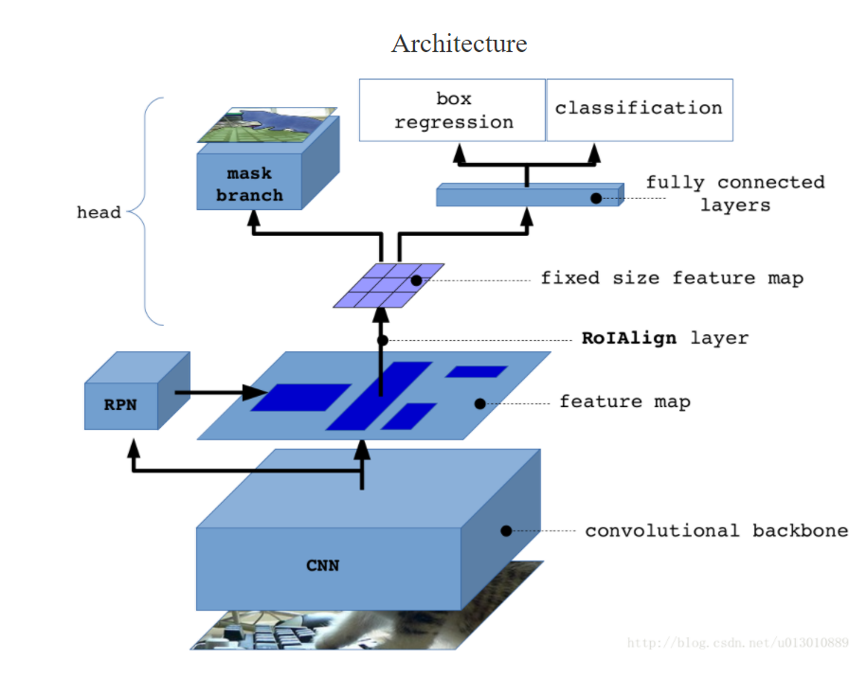
Mask-RCNN

Slide 9
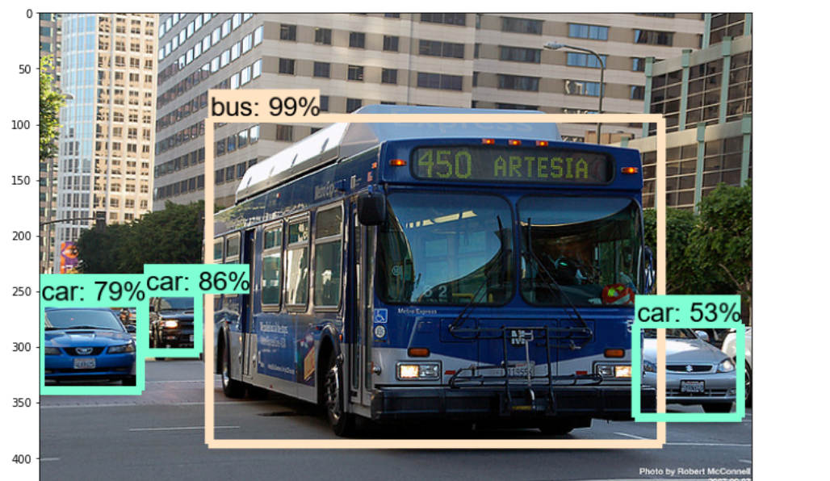
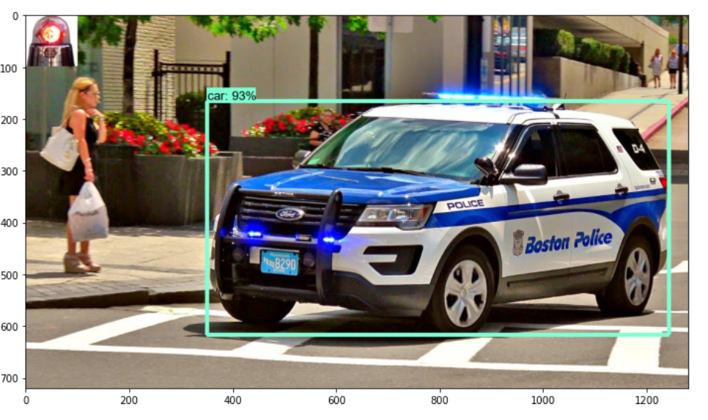
Results of SSD- MobileNet

Slide 10
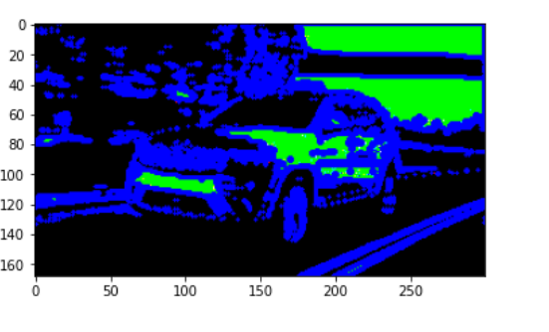
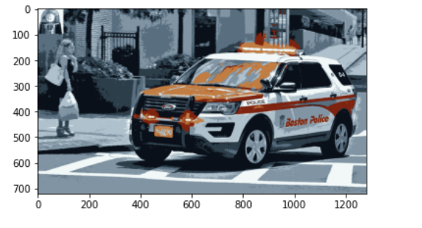
Results of Region based clustering Using KNN

Slide 11
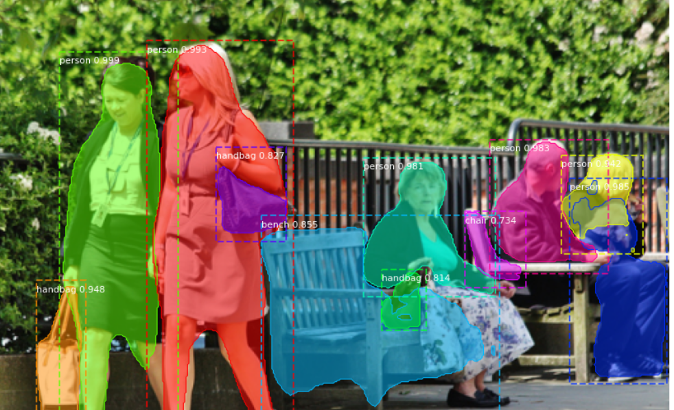
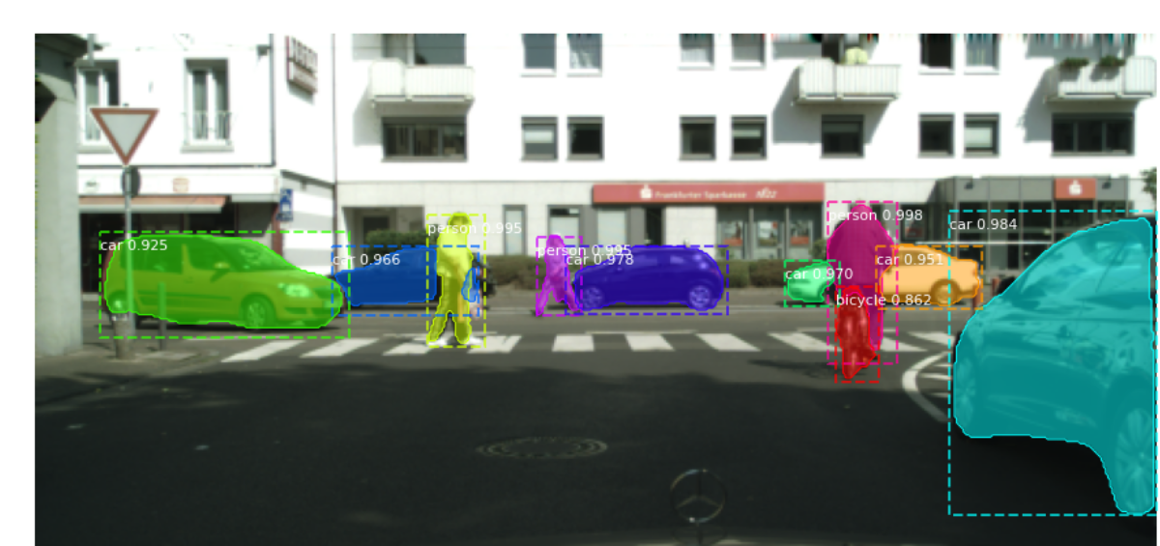
Results of Mask RCNN

Slide 12
Application and Future Scope
Application:
Medical Application
Autonomous driving
Surveillance systems
Future Scope:
We can use OpenCV which provides real time object detection.
We can use Detectron2 is Facebook AI Research's next generation software system that implements state-of-the-art object detection algorithms. It is a ground-up rewrite of the previous version, Detectron, and it originates from maskrcnn-benchmark.

Slide 13
References
SSD official Paper: https://arxiv.org/pdf/1512.02325.pdf
COCO Dataset: https://cocodataset.org/#home
CityScape Dataset: https://www.cityscapes-dataset.com/
Mask RCNN Paper: https://arxiv.org/abs/1703.06870
Mask RCNN Official Code: https://paperswithcode.com/paper/mask-r-cnn#code

Slide 14

Thank You

